Slide 1
Digital Marketing Specialist

Slide 2
Assignment
In your teams choose business idea.
Notes:
المطلوب تنفيذه اليوم ؟
اختاروا فكرة تجارية

Slide 3

Foundations of Marketing Second Lecture

Slide 4
The Assignment
In your teams Explain the importance of understanding the marketplace and customers through a product or a service from your choice explaining:
Your target market
Customers’ needs and wants
Choosing your value proposition& brand voice
Create SMART Objectives
SWOT Analysis
Product, Pricing, Place, and Promotion Strategy
Segmentation, Targeting

Slide 5


Introduction of Digital Marketing

Slide 6
The Assignment
In your teams Create Digital marketing objectives

Slide 7
Introduction to Social Media Marketing

Slide 8
The Assignment
Review & analysis the social media published report and Choose the right channels for your project

Slide 9

Introduction to Content Marketing

Slide 10
Assignment
Write a story for your product based on Storytelling frameworks

Slide 11

Basics of SEO Search Engine Optimization

Slide 12
Activity
Practice on Google Keyword Planner& Analyze keyword search volume, competition, and relevance

Slide 13
Assignment
Conduct a Keyword research for your project

Slide 14

Visual Content
Creation

Slide 15


The Assignment
Create Video, blog post, Email banner, and One Landing Page website by using Canva

Slide 16

Content Strategy Development
Content planning
part I

Slide 17
The Assignment
Define content objectives for your project
Undergo competitor analysis
Define your key message

Slide 18
Content Strategy Development
Content planning
part II

Slide 19
The Assignment
Create a content calendar for your project
Set the objectives you want to accomplish according to the buyers' journey
Define the content tools you would utilize with your team in your content plan
Set the possible KPIs to monitor your progress in your content plan

Slide 20
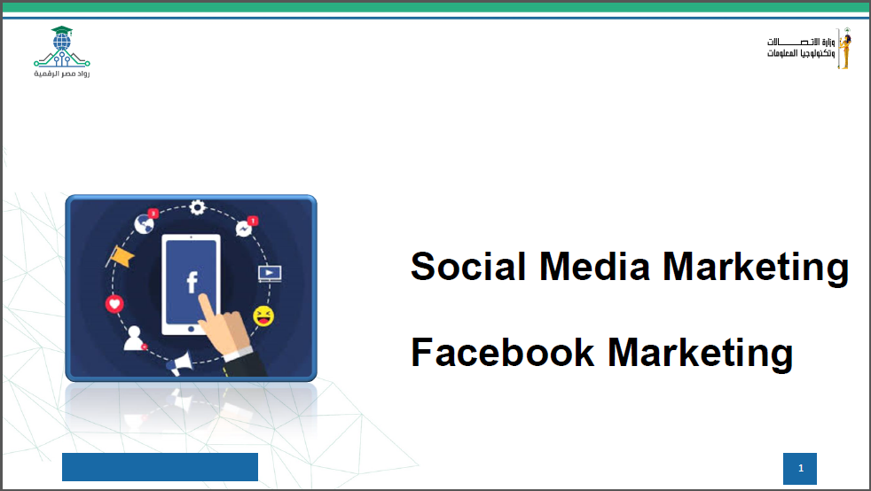

Slide 21
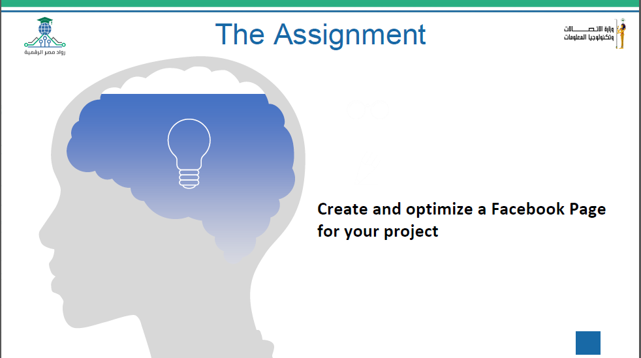

Slide 22

Social Media Marketing
Instagram Marketing

Slide 23
The Assignment
Create and optimize a professional Instagram account for your project

Slide 24

Social Media Marketing
Meta Business Suite

Slide 25
The Assignment
Connect your Instagram profile to your Facebook page
Monitor a topic related to your product using one of the listening tools like Google alerts, Buzzsumo, Hootsuite, Buffer or Databox.
Add 3-5 Facebook or Instagram business to watch on your business suite.

Slide 26

Social Media Marketing
Meta Advertising

Slide 27
The Assignment
Draft One campaign for Awareness, another one for Engagement using Ads Manager

Slide 28
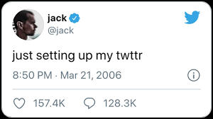
Social Media Marketing
X Marketing

Slide 29
The Assignment
Create a professional X Account For your Business.
Publish 3 posts with suitable hashtags

Slide 30

Social Media Marketing
TikTok Marketing

Slide 31
The Assignment
Create TikTok business account for your business
Create a TikTok content calendar
Publish 3 posts on your account.

Slide 32

Social Media Marketing
Snapchat Marketing

Slide 33
The Assignment
Create Snapchat account for your business
Publish 3 posts using Snapchat features.

Slide 34

Social Media Marketing
Linkedin Marketing

Slide 35
The Assignment
Optimize your LinkedIn Profile adding a post that you are currently studying at DEPI.
Create LinkedIn Page For your Business
Add 3 Posts suitable to your business & LinkedIn Target Audience

